Slide 1
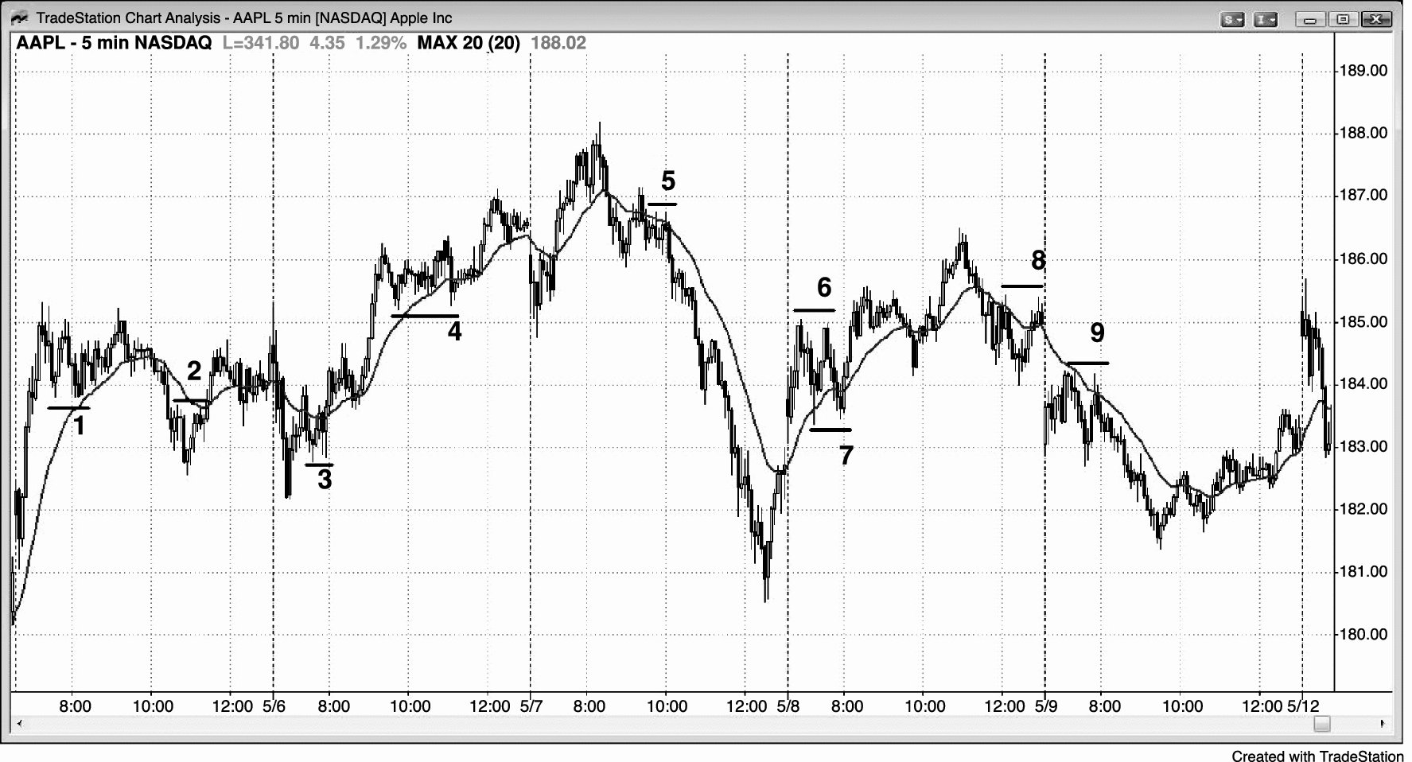
FIGURE 12.1 Bull Flags

Slide 2
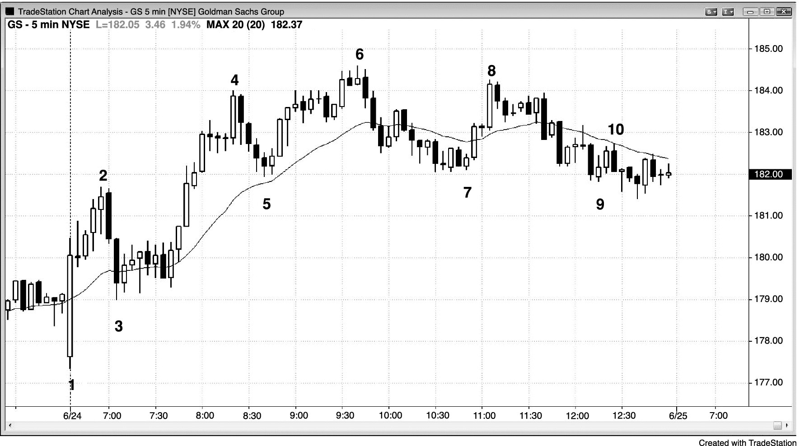
FIGURE 12.2 Double Bottom Bull Flag

Slide 3
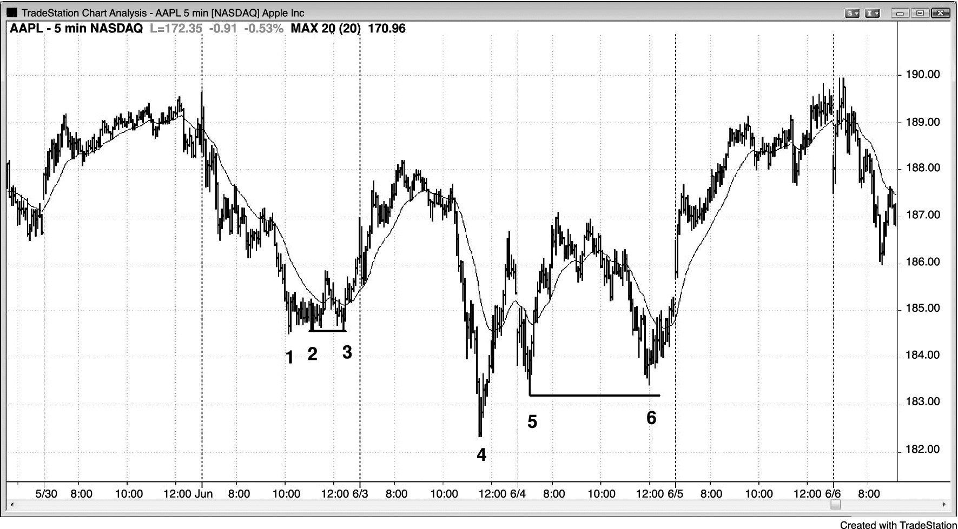
FIGURE 12.3 Double Bottom Bull Flags

Slide 4
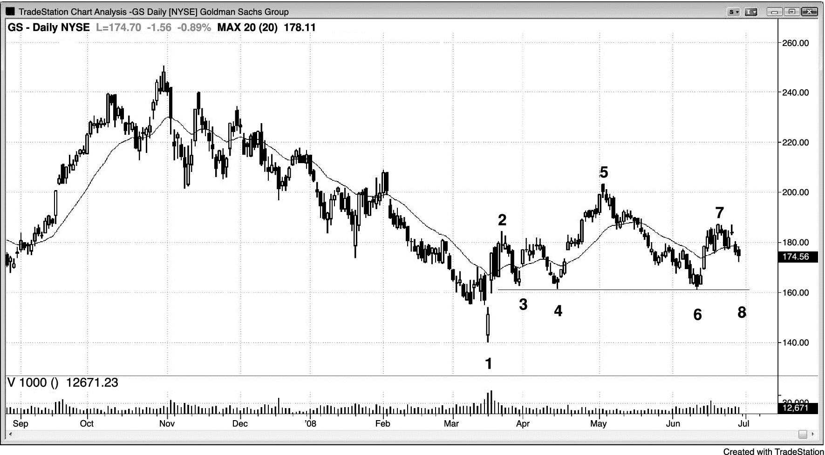
FIGURE 12.4 Head and Shoulders Top or Double Bottom

Slide 5
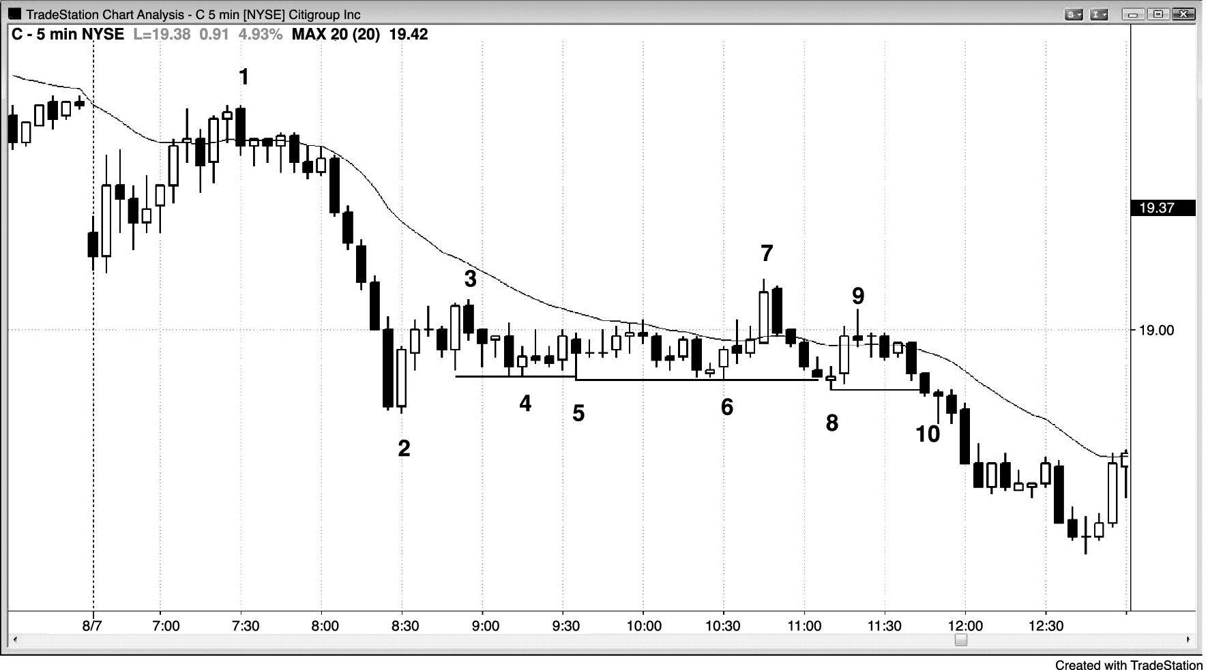
FIGURE 12.5 Failed Double Bottom

Slide 6
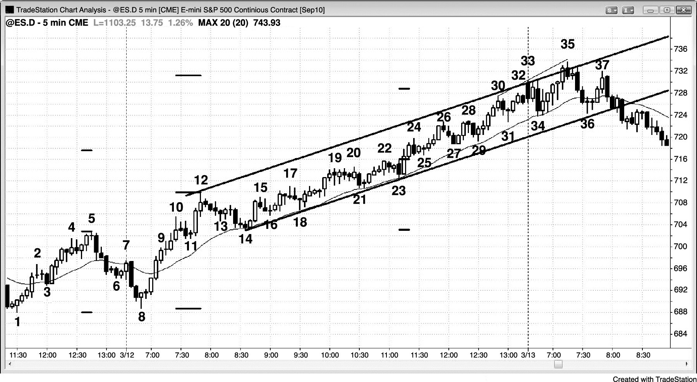
FIGURE 12.6 Double Bottom Bull Flag and a Measured Move Up

Slide 7
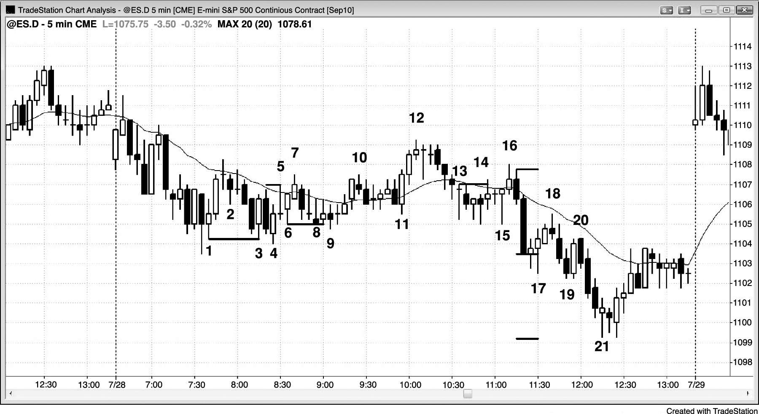
FIGURE 12.7 Failed Double Bottom Breakout Is a Wedge Variant

